Slide 1
Internship Presentation

Slide 2

INTRODUCTION TO THE COMPANY
KG-MECH Contracting Over the years, KG MECH Electro -Mechanical Pvt. Ltd has actively involved in MEP Engineering Services& Solutions for major projects in the Gulf. Since its inception, KG-MECH has grown considerably to become a leading solution provider in all aspects of Electro Mechanical Engineering.

Slide 3
OVERVIEW AND VISION & MISSION
Overview : KG Mech Electro-Mechanical pvt. Ltd. Is a leading provider of electro-mechanical serviced, specializing in HVAC (heating, ventilation and air conditioning), electrical, plumbing and fire protection system. With a strong commitment to quality, safety and customer satisfaction, KG Mech has established itself as a trusted partner for various industries, including commercial, industrial and residential sectors.
VISION
To Provide Practical & Industry Oriented Real Time Training, as a leading corporate training provider in Construction Industry Sector.
Mission:
To deliver exceptional electro-mechanical solutions that exceed customer expectations, while ensuring safety, quality and environmental sustainability.

Slide 4
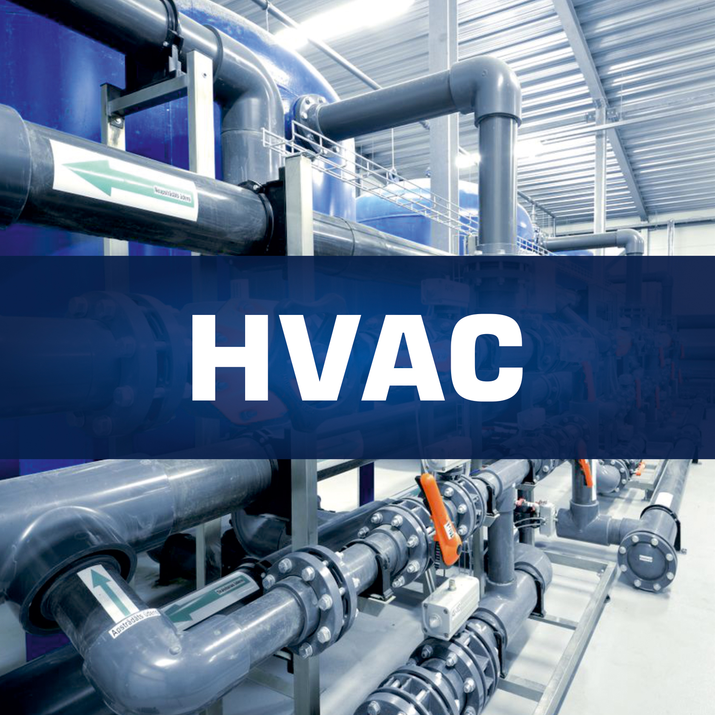
Department and it’s function
Design and Planning
Department and it’s function
Energy management
Maintenance and Repair
Quality Control and Assurance

Slide 5
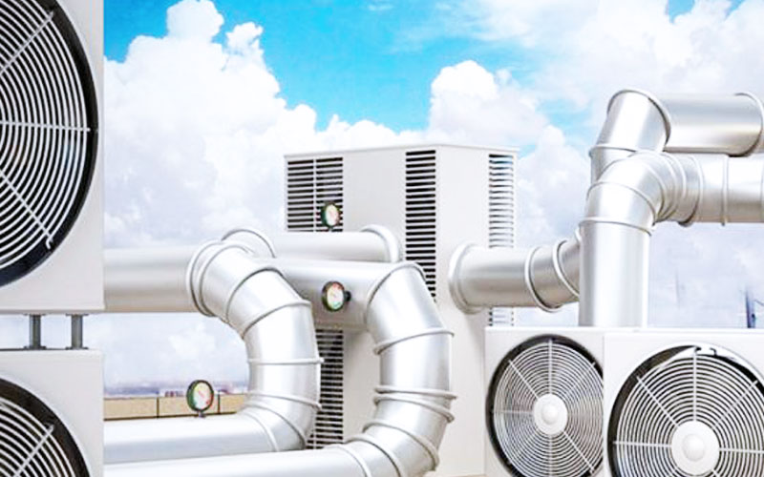
Services: HVAC design, installation, and maintenance Electrical services, including power distribution, lighting, and control systems Plumbing services, including water supply, drainage, and gas piping Fire protection systems, including design, installation, and maintenance Project management and consultancy services

Slide 6
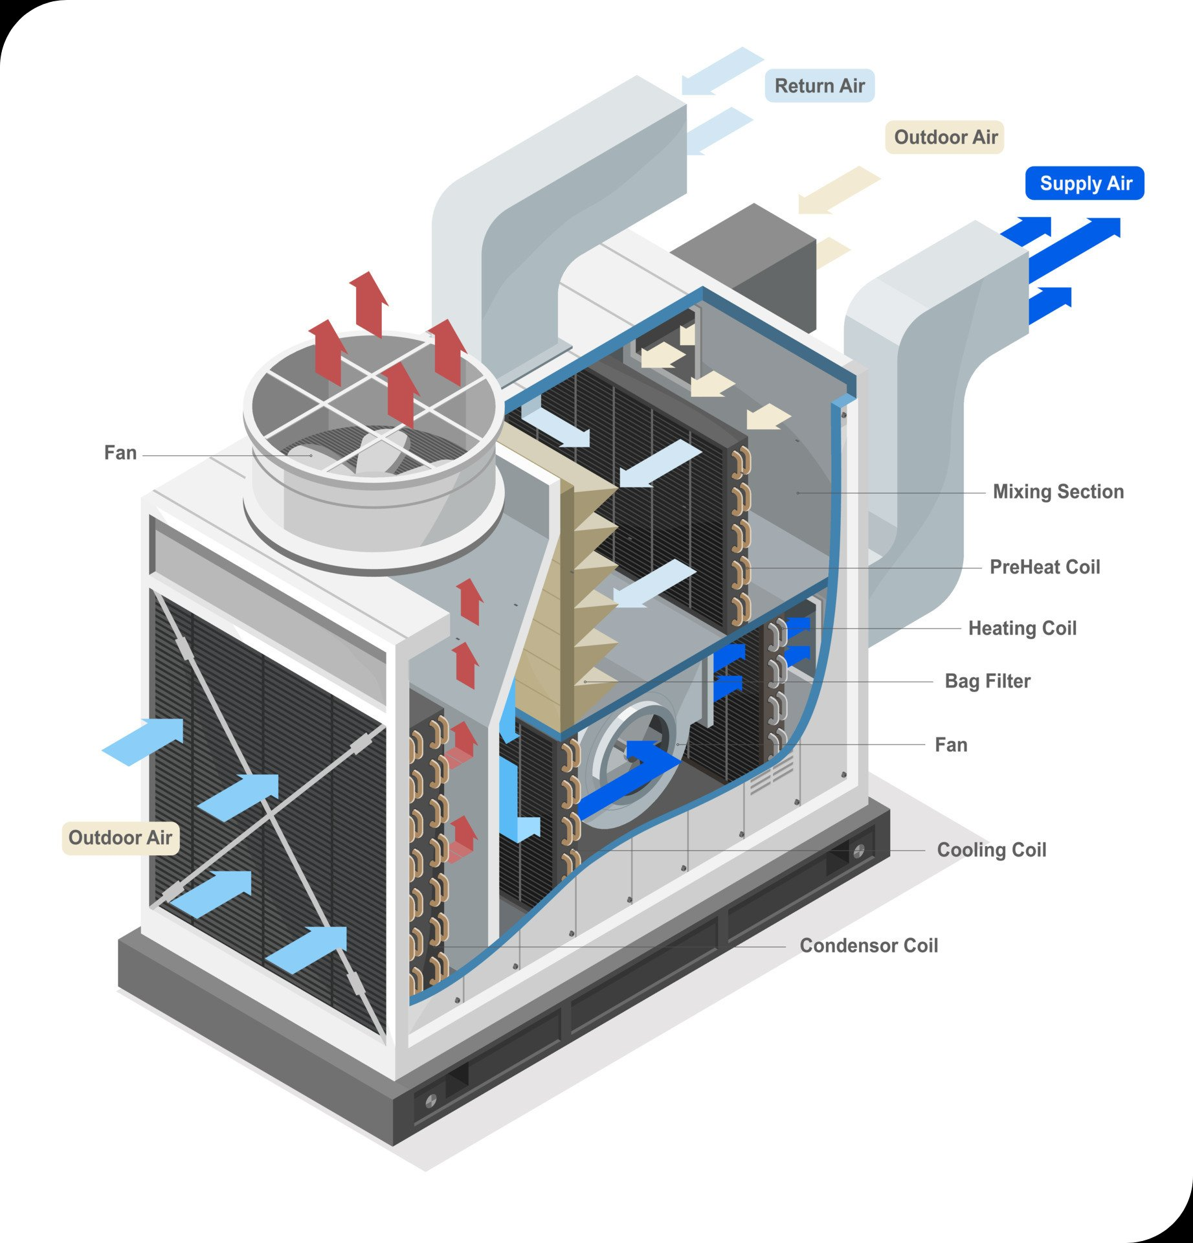
SKILLS/KNOWLEDGE ACQUIRED
HVAC system Design mechanical engineering project management energy efficient maintenance and troubleshootin
Regulating Compliance
Customer services
Safety Practices

Slide 7
SCOPE & FUTURES OF HVAC SYSTEMS
Scope:
1 . Commercial and Industrial Building
2. Industrial Processes
3. Residential Projects
4. Institutional Buildings
Futures:
Sustainability and Energy Efficiency
Smart HVAC Systems
Indoor Air Quality (IAQ)
Modular and Prefabricated HVAC

Slide 8
Conclusion
Overall, my internship at KG Mech Electro Mechanical was a valuable learning experience that
provided me with practical skills and insights into the HVAC industry. It helped me understand the
importance of efficient system design and the impact it has on building performance and energy
consumption. The experience has motivated me to continue developing my expertise in this field
and contribute to the advancement of HVAC technology

Slide 9


